Slide 1
BOARD MEETING JUNE 19, 2019

Slide 2
AGENDA
Welcome
Approval of Minutes from April 1, 2019 Board Meeting
Program Expansion Update
2019-20 Career & Technical Scholarship
WSOS Leadership Transition
Finance and Program Administrator Update
WSOS Program Update and Reflection
Closing

Slide 3
PROGRAM EXPANSION
Year 1 Update

Slide 4
BOARD DIRECTIVE
In spring 2017, the Board of Directors instructed the WSOS team to recommend the best use of available funds to grow the Baccalaureate Scholarship program. The options considered were to: 1) increase the scholarship amount per student; 2) increase the number of Scholars funded; or 3) grow program supports. In December 2017, the Board voted to use the funds for program expansion with specific focus on building a near-peer mentoring model.

Slide 5
KEY ELEMENTS OF PROGRAM EXPANSION
Launch near-peer mentoring model with 2018-19 inaugural year of the Scholar Lead program.
Expand industry mentoring model through 100% third-year participation in Skills that Shine.
Notes:
*Required for Cohort 7 Scholars only

Slide 6
SIGNATURE PROGRAM:
Scholar Lead Near-Peer Mentoring
The goal of the Scholar Lead program is to leverage near-peer mentoring to improve persistence outcomes, ensuring academic and social success for first- and second-year Scholars.

Slide 7
SCHOLAR LEAD PROGRAM ELEMENTS
Recruited 152 Scholar Leads; 145 retained in 2018-19
Trained Scholar Leads at training events across the state (Puget Sound, Pasco, Spokane, online)
Provided ongoing support to all Leads
~35 Leads per Advisor
Leads provided ongoing support to all mentees
~15 mentees per Lead
>16,000 contacts made with mentees!
Leads received total stipend of $1,800

Slide 8
SIGNATURE PROGRAM:
Skills that Shine Industry Mentoring
The goal of the Skills that Shine program is to leverage industry mentoring to enhance Scholars’ career readiness skills and network, ensuring a smoother transition from college to career.

Slide 9
SKILLS THAT SHINE PROGRAM ELEMENTS
Designed a proprietary matching platform
Converted & updated prior StS curriculum to online platform
Recruited 167 mentors from 63 companies
208 third-year Scholars received mentorship
Provided ongoing support to all mentors & mentees
Culminating networking celebration in Spokane & Seattle
Notes:
Embedded curriculum assessments

Slide 10
Panelists:
Skills that Shine Mentor
DOUGLAS BARRANCOTTO, Chief of Staff, Azure Dedicated, Microsoft
Skills that Shine Mentee
TIN VO, Electrical Engineering, University of Washington
Scholar Lead
WENDY NI, Biochemistry, University of Washington
Moderators:
HANNAH OLSON, WSOS Talent Resource Manager
PATRICK KANG, WSOS Scholar Success Advisor
Notes:
Embedded curriculum assessments

Slide 11
OUTCOMES: KPIs & GOALS
Renewal Survey Open Until June 30
COMING SOON! September BOD Meeting
Satisfaction questions on Scholar Lead program
Satisfaction questions on StS program
First look at persistence impacts (Y1 to Y2, Y2 to Y3)
Notes:
We will also address actuals on KPIs for 2018-19 and set goals for 2019-20 on programmatic outcomes

Slide 12
CAREER AND TECHNICAL SCHOLARSHIP
Application & Selection

Slide 13
goal
Vote on the 2019-20 Career and Technical Scholarship selection criteria
Overview
Profile of CTS applicants
Selection model recommendation

Slide 14
Career and technical scholarship
$1,500 per quarter, plus support services
Associate degrees, certificates and apprenticeships
High-demand STEM, health care and trade jobs
Notes:
[Acknowledge that all Scholars are Opportunity Scholars—we have Baccalaureate OS and Career and Technical OS]

Slide 15
Eligible programs
Eligible programs determined per college
Must be:
High-demand based on statewide or regional data
STEM, health care or trade
A credential appropriate for the field
Affirmed by colleges and workforce development councils statewide

Slide 16
Application
Selecting 550 scholars for the 2019-20 academic year
Application open three times per year
Fall: 275 selects
Winter: 165 selects
Spring: 110 selects
Fall 2019 application opened May 20, closes July 12
Notes:
Note: Why the cycle is different and why they don’t have live data for *this* selection criteria discussion

Slide 17
CTS Applicant profile (preview)
Intended Program | Percent of Applicants
Nursing | 24%
Medical Assistant / Technician | 18%
Information Technology | 15%
Medical Support Services | 13%
Manufacturing & Engineering | 10%
Automotive / Heavy Engine | 6%
Welding | 4%
Construction & Architecture | 4%
Other | 6%

Slide 18
CTS Applicant profile (preview)
Gender
Median Income
$22,363
percent
Notes:
Of the first 179 applicants
Speak to the fact that this scholarship lets us reach a whole new population

Slide 19
Financial context
~$11,200
Avg. Cost of Attendance

Slide 20
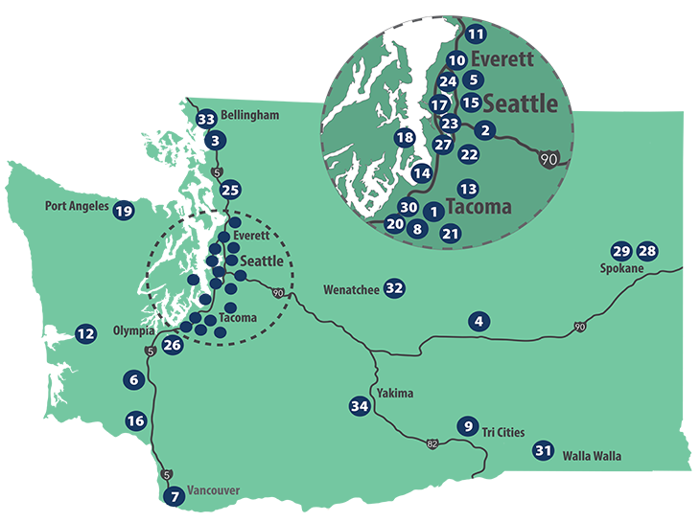
Geographic context
Community college graduates more likely to live and work in the same community both during and after school
Many rural communities are 1-4 hours from the nearest community or technical college*
* Particularly those with the highest rates of unemployment
Notes:
Note: Talking about this because of our commitment to serving the whole state
Supporting COA is particularly importance, given that…

Slide 21
Academic context
What predicts CTC completion?
Every 1 point increase in HS GPA translates to a 22% greater likelihood of completing
Students who receive a Pell Grant are 7.5% more likely to complete
Enrolling in a program in the first year leads to a 66% greater likelihood of earning a credential or transferring to a 4-year institution within 3 years
39% of CTC students earn any credential within 6 years
Notes:
Full-time students have a 55% 6-year completion rate, while part-time students have a 6-year completion rate of less than 20% (NSC). For comparison, the 6-year completion rate at 4-year institutions is ~60% (https://nces.ed.gov/fastfacts/display.asp?id=40).
What predicts CTC completion? (ACE & CPR) (Roadmap for the first year program enrollment: https://roadmapproject.org/wp-content/uploads/2018/12/CTC-Pathways-in-South-Seattle-and-South-King-County-Full-Report-Oct.-2018.pdf)
Our big goal? 66% completion.

Slide 22
Selection goals
Prioritize impact statewide in specific, high-demand fields
Select Scholars highly likely to complete their program
Promote equity of access to higher education
Notes:
Same guiding principles as the Baccalaureate Scholarship.
For this scholarship to be successful…

Slide 23
CTS selection model
Criteria | Baseline (Baccalaureate C8) | Option A | Option B
GPA | 20% | 20% | 25%
Essay(s) (Resilience) | 20% | 15% | 15%
Intended Program | 20% | 20% | 15%
Family Income | 20% | 20% | 20%
First Generation | 12% | 10% | 10%
Community Opportunity | 8% | 15% | 15%
Additional Recommendation: Select a minimum of 2 applicants per CTC for Fall 2019
Notes:
[Introduce the criteria, but before beginning discussion bring them to the additional recommendations on the next slide]

Slide 24
LEADERSHIP TRANSITION
Update
Acting Executive Director Policy

Slide 25
FINANCE & PROGRAM ADMINISTRATOR UPDATE

Slide 26
WSOS Balance Sheet
Comparative Balance Sheets
April 30, 2019
 |  | Comparison to Last Reported Period |  |  |  |  |  | Comparison to Same Period LFY
 |  | 12/31/18 | % Change | 4/30/19 |  | Notes |  | 4/30/18 | % Change | 4/30/19
 | Assets
 | Cash | 1,856,309 | 79% | 3,331,747 |  | 1 |  | 16,906,938 | -80% | 3,331,747
 | Investments | 106,376,459 | 3% | 109,838,783 |  | 2 |  | 98,590,398 | 11% | 109,838,783
 | Accounts Receivable | 46,188 | -10% | 41,674 |  |  |  | 30,097 | 38% | 41,674
 | Pledges and Grants Receivable, net | 9,543,424 | -27% | 7,008,222 |  | 3 |  | 12,438,262 | -44% | 7,008,222
 | State match receivable, net | 2,960,105 | 72% | 5,081,260 |  | 4 |  | 4,652,610 |  | 5,081,260
 | Prepaid Expenses | 29,412 | 220% | 94,054 |  |  |  | 139,618 | -33% | 94,054
 | Property and equipment, net | 40,071 | -2% | 39,165 |  |  |  | 41,725 | -6% | 39,165
 | Total Assets | 120,851,968 | 4% | 125,434,905 |  |  |  | 132,799,648 |  | 125,434,905
 | Liabilities and Net Assets
 | Accounts Payable | 115,868 | -25% | 87,135 |  |  |  | 111,385 | -22% | 87,135
 | Payroll Related Liabilities | 128,314 | -42% | 74,949 |  |  |  | 68,891 | 9% | 74,949
 | Scholarship Commitments, net | 31,203,035 | -13% | 27,269,050 |  | 5 |  | 23,479,533 | 16% | 27,269,050
 | Total Liabilities | 31,447,217 | -13% | 27,431,134 |  |  |  | 23,659,809 | 16% | 27,431,134
 | Net Assets
 | Temporarily Restricted Net Assets | 64,404,751 | 13% | 73,003,771 |  |  |  | 84,139,839 | -13% | 73,003,771
 | Permanently Restricted Net Assets | 25,000,000 | 0% | 25,000,000 |  |  |  | 25,000,000 | 0% | 25,000,000
 | Total Net Assets | 89,404,751 | 10% | 98,003,771 |  |  |  | 109,139,839 | -10% | 98,003,771
 | Total Liabilities and Net Assets | 120,851,968 | 4% | 125,434,905 |  |  |  | 132,799,648 | -6% | 125,434,905

Slide 27
WSOS Balance Sheet
Notes:
Increase in cash December-April largely due to receipt of MSFT pledge payment of $2.5M at the end of April. April excess private receipts invested in WSIB in May. Maturing fixed income securities covered scholarship disbursements net of refunds of $3.7M.
Investments balance as of 4/30/19 includes WSIB Scholarship $70.3M, WSIB Endowment $30.2M and KeyBank Capital $9.3M. Total investments higher due to strong investment gains after reduction for spring scholarship disbursements.
Balance includes Rubens Family Foundation: $7.0M and other individuals: $8K.
WSAC matched $521K between January and April. The state match accrual of April private receipts of $2.56M was recorded in April. Remaining amount includes this and resubmission. WSOS did receive $1.67M of $2.8M resubmission in May. Still working to get remaining balance.
The decrease from December to April is a result of scholarship disbursements totaling $3.94M.

Slide 28
WSOS Income Statement
Actual vs. Budget
Four Months Ending April 30, 2019
 |  | Four Months Ended April 30, 2019 |  |  |  |  |  | December 31, 2019
 |  | Actual |  | Budget |  | Variance Fav (Unfav) | Notes | Annual Budget
Revenue
Private |  | 99,475 |  | 1,550,000 |  | (1,450,525) | 1 | 6,200,000
Public |  | 2,641,832 |  | 1,550,000 |  | 1,091,832 | 2 | 15,700,000
Investment Income |  | 6,552,275 |  | 972,400 |  | 5,579,875 | 3 | 2,917,200
Total Revenue |  | 9,293,582 |  | 4,072,400 |  | 5,221,182 |  | 24,817,200
Program Expense
Salaries and Benefits |  | 557,478 |  | 542,390 |  | (15,088) | 4 | 1,898,633
Professional Fees - Program Admin fees |  | 171,180 |  | 171,180 |  | - |  | 513,540
Professional Fees - Contractors & Lobbying |  | 98,470 |  | 50,250 |  | (48,220) | 5 | 523,500
Conferences, Conventions & Meetings |  | 32,376 |  | 39,471 |  | 7,094 |  | 233,045
Operating Expenses |  | 88,184 |  | 77,260 |  | (10,924) | 6 | 239,800
 |  | 947,689 |  | 880,550 |  | (67,138) |  | 3,408,518
Income (Loss) before Scholarship Exp |  | 8,345,893 |  | 3,191,850 |  | 5,154,043 |  | 21,408,682
Scholarship Expense |  | (253,127) |  | (228,000) |  | 25,127 | 7 | 24,338,506
Net Income (Loss) |  | 8,599,020 |  | 3,419,850 |  | 5,179,170 |  | (2,929,824)

Slide 29
WSOS Income Statement
Notes:
Revenue Private: The 2019 Budget includes $1.2M for 4-year scholarship and $5M for CTS, divided evenly by quarter throughout the year. Actual new revenues includes CWU/Hanson: $50K and Battelle Foundation: $25K.
Revenue Public: State match revenues accrued based on $2.64M of private contributions received between January and April, including $2.5M MSFT pledge payment. MSFT budget amount in May.
Investment income: Actual YTD includes unrealized/realized gains of $6.37M, interest & dividend income of $202K and investment expense of <$20K>. Budget does not include Unrealized G/L.
Salaries and benefits: Slightly over as bonus payouts in 2019 for 2018 was higher than 2018 accrual. Also, salary increases went into effect.
Professional Fees – Actual expense over budget in part due to I.T., Temp Support, Communications and Recruitment efforts.
Operating Expenses – Actual expense over budget due in large part to printing costs.
Represents scholarship refunds to date. Scholarship expense for CY 2019 has not been recorded yet. All payouts so far are applied to the liability established in prior years. Will adjust liability once Cohort 8 has been selected and accepted.

Slide 30
WSOS Cash Flow
Cash Flow Summary
Inception-To-Date
April 30, 2019
 |  |  |  | Inception - April 30, 2019
 |  |  |  | Scholarship |  | Endowment | Notes | Total
CASH FLOW
Cash Inflow:
 | Boeing |  |  | 12,610,000 |  | 12,500,000 |  | 25,110,000
 | Microsoft |  |  | 35,000,000 |  | - | 1 | 35,000,000
 | Other Private |  |  | 30,836,702 |  | - | 2 | 30,836,702
 | State |  |  | 73,157,294 |  | 12,500,000 | 3 | 85,657,294
 | Investment Income* |  |  | 10,680,490 |  | 5,204,420 | 4 | 15,884,910
 |  | Total Cash Inflows |  | 162,284,486 |  | 30,204,420 |  | 192,488,906
Cash Outflow:
 | Scholarships |  |  | (64,157,751) |  | - | 5 | (64,157,751)
 | Program Expenses |  |  | (15,154,814) |  | (5,812) |  | (15,160,626)
 |  | Total Cash Outflows |  | (79,312,565) |  | (5,812) |  | (79,318,377)
 | Net Cash Flow Inception-To-Date |  |  | 82,971,921 |  | 30,198,608 |  | 113,170,529
Composition of Net Cash Flow
 | KeyBank Checking Account |  |  | 3,331,747 |  | - | 6 | 3,331,747
 | Investment Accounts at WSIB and KeyBank |  |  | 79,640,174 |  | 30,198,608 |  | 109,838,782
 | Total |  |  | 82,971,921 |  | 30,198,608 |  | 113,170,529
* Includes unrealized gains and losses.

Slide 31
WSOS Cash Flow
Notes:
Cash Inflow: Microsoft - $2.5M pledge payment received in April 2019. Final installment of original pledge.
Cash Inflow: Other Private - $142K received on cash basis between January and April 2019, including CWU/Hanson: $50K, Rubens Family Foundation: $26K, and Battelle Foundation: $25K.
State – Received $521K from WSAC between January and April 2019.
Investment Income – Includes net unrealized gains from inception of $8.8M (Scholarship: $5.3M and Endowment: $3.5M). YTD 2019 the total unrealized gains are $6.4M, offsetting the loss from 2018.
Scholarship disbursements were $3.9M during this time and scholarship refunds totaled $254K.
WSOS Cash in KeyBank – Excess cash received after MSFT pledge payment in April was invested in WSIB in May and excess state match dollars were invested with KeyBank

Slide 32
PROGRAM UPDATE & REFLECTION

Slide 33
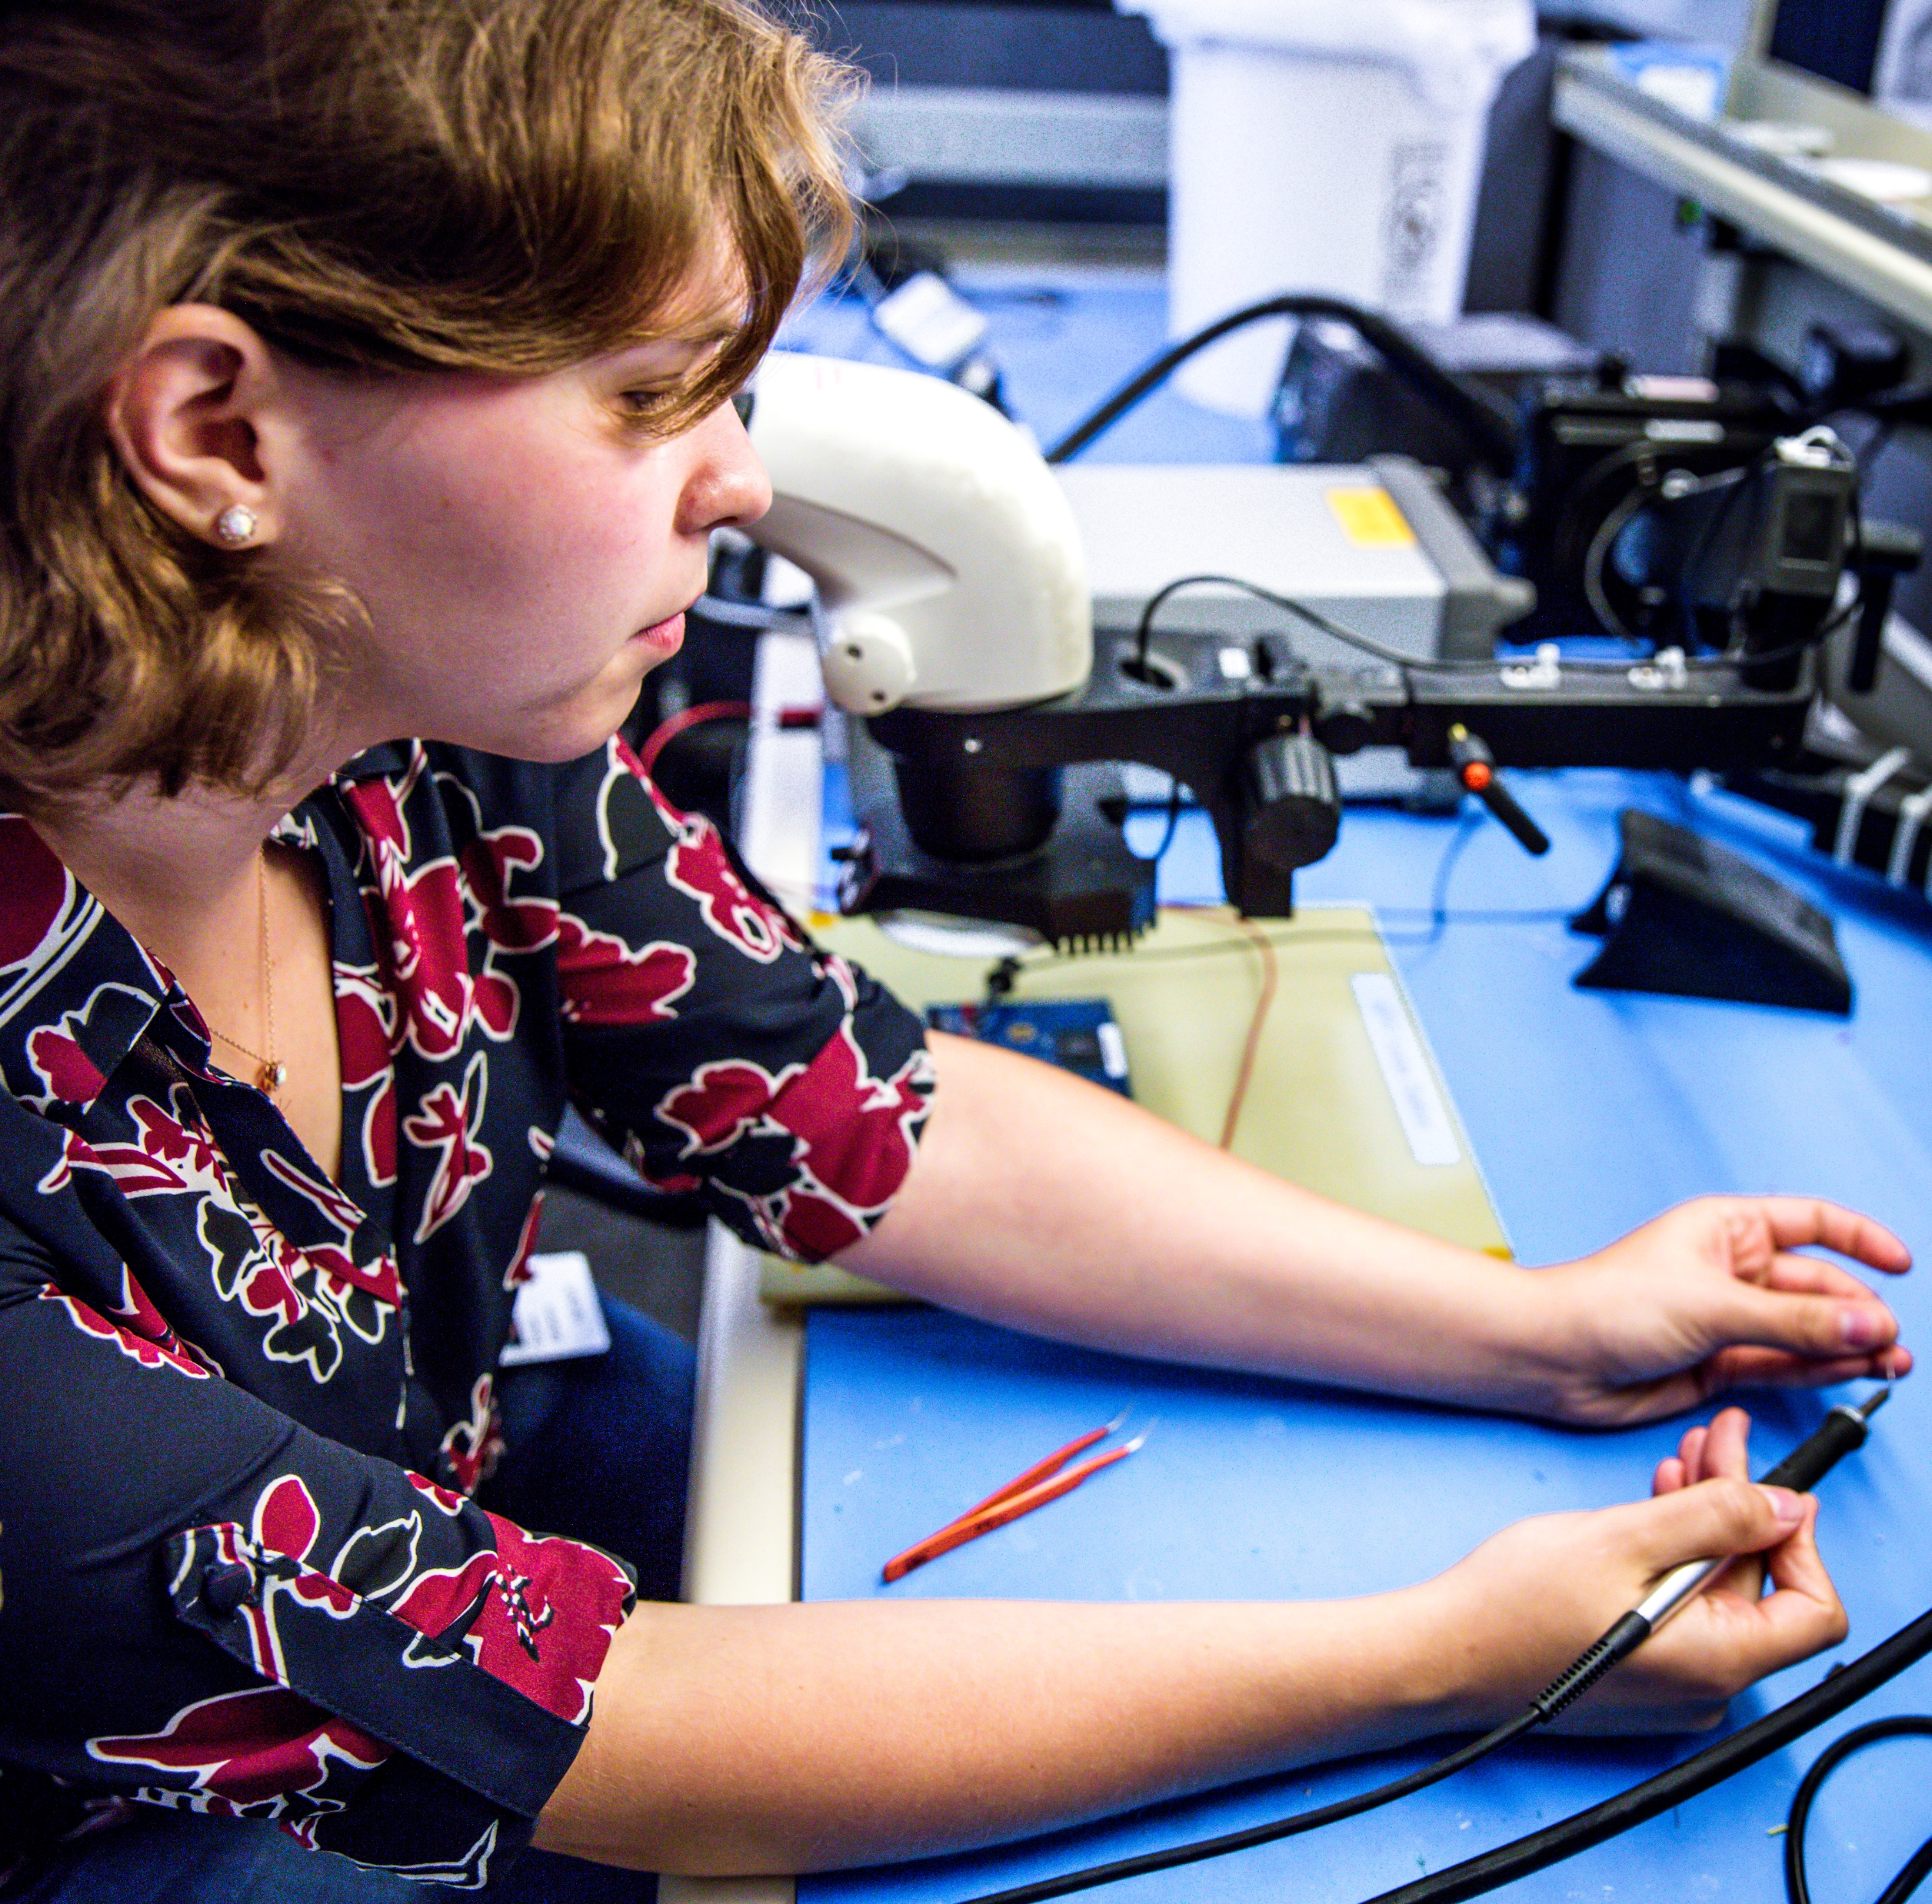
SCHOLAR PROGRAMMING UPDATE
Cohort 8 Scholar Acceptance
Scholar Renewal
Opportunity OutLoud
WSOS Internship Insider

Slide 34
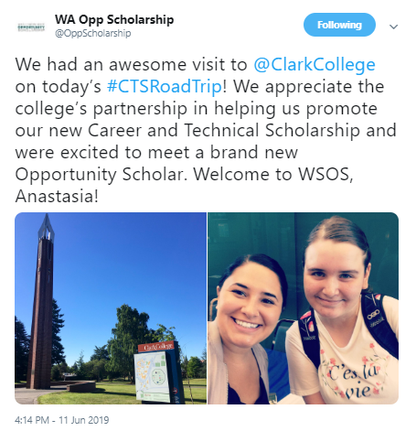
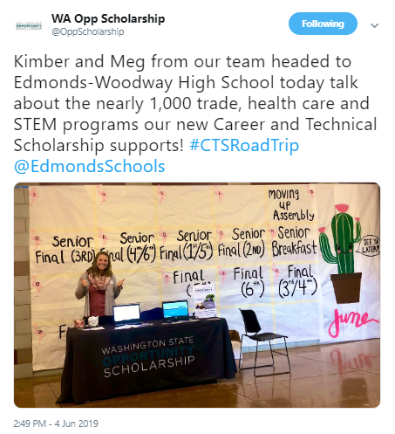
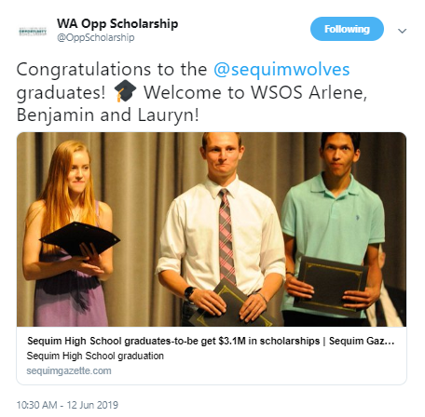
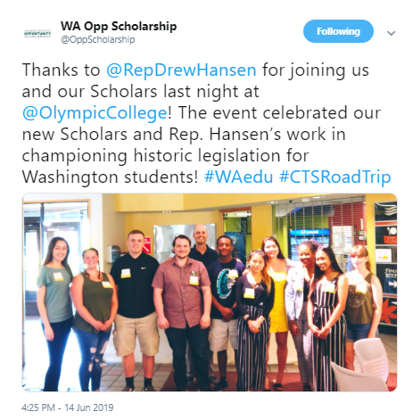
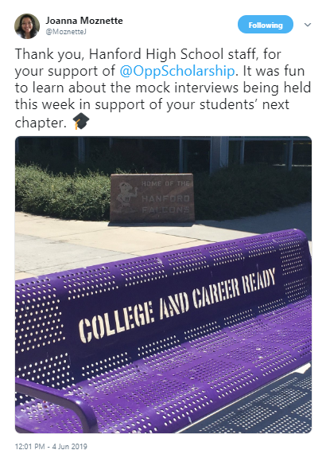
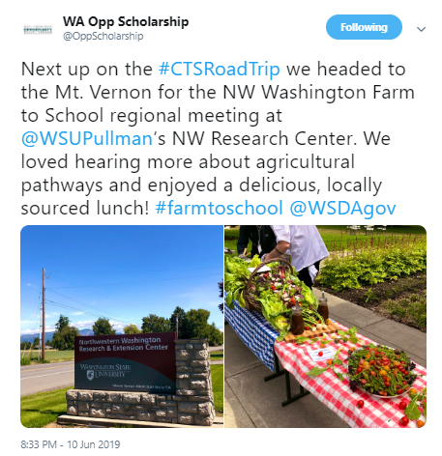
WSOS ROAD SHOW

Slide 35
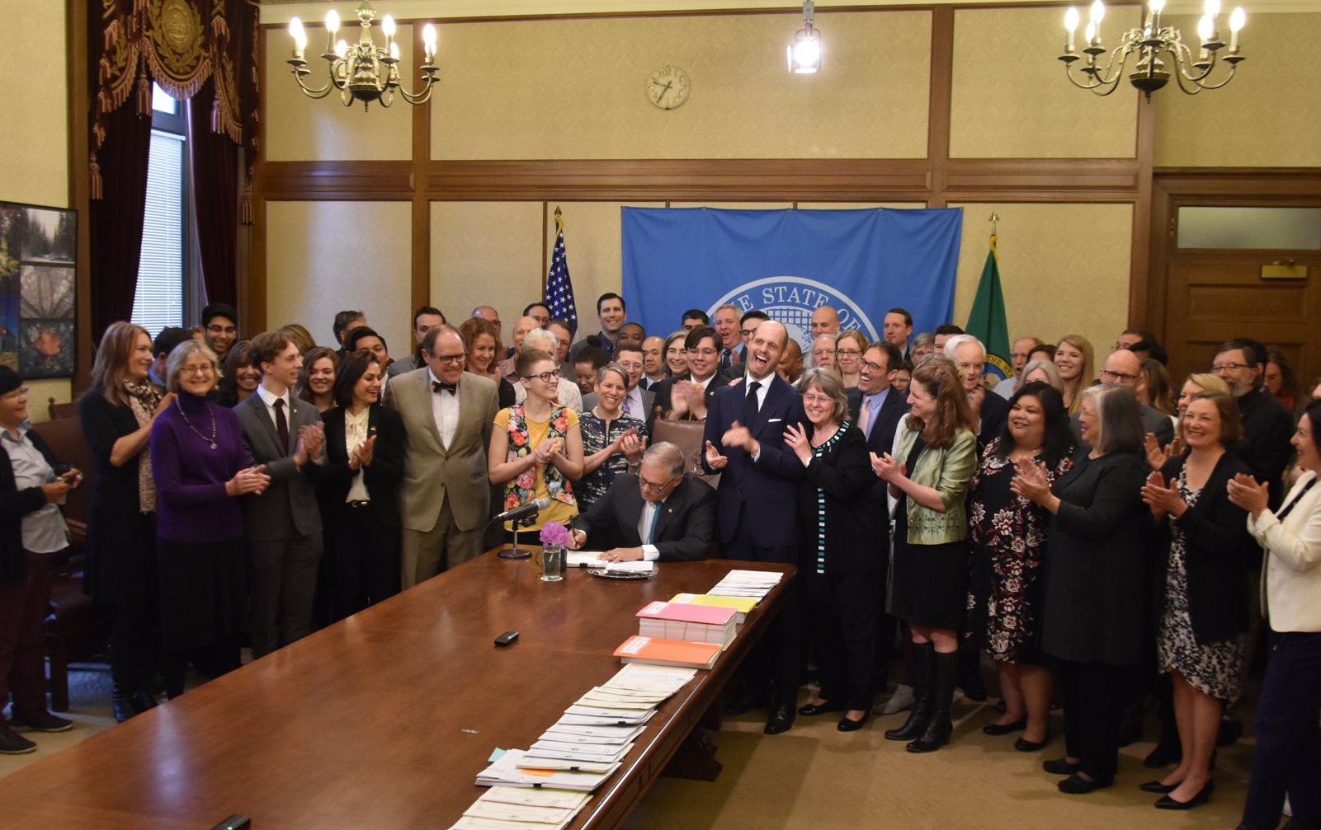
LEGISLATIVE SESSION UPDATE
Workforce Education Investment Act (HB2158)
Definition of “private sources” to include municipal and tribal funds
College Bound fix
Career Connect Washington
Washington Civil Rights Act (I-1000)

Slide 36
2019 OTALKS
Goal
Theme
July 12, 2019
Registration Open
Save the Date Notices Emailed/Mailed

Slide 37
Reflection
Notes:
Same guiding principles as the Baccalaureate Scholarship.
For this scholarship to be successful…

Slide 38
BOARD MEETING JUNE 19, 2019

